Slide 1


The Battle of the Neighborhood
Coursera Applied Data Science Capston Final Test

Slide 2
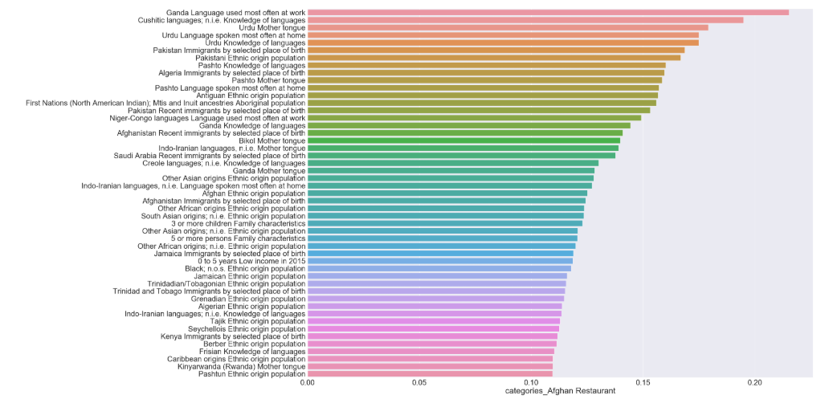
correlation between Afghan restaurants and demographic information.

Slide 3
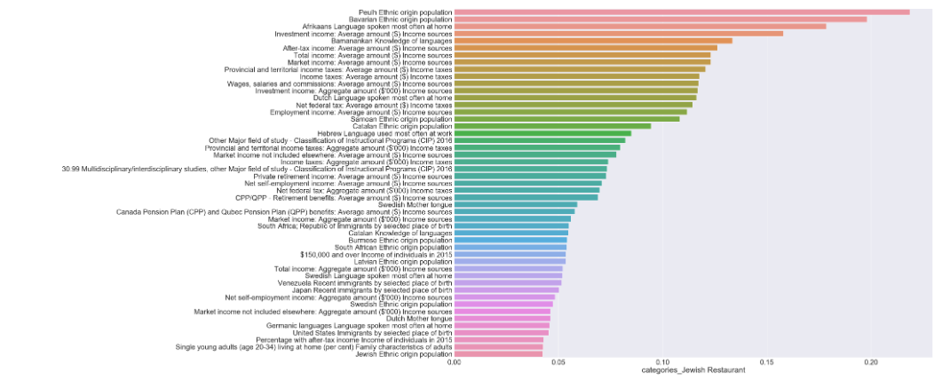
correlation between Jewish restaurants and demographic information.

Slide 4
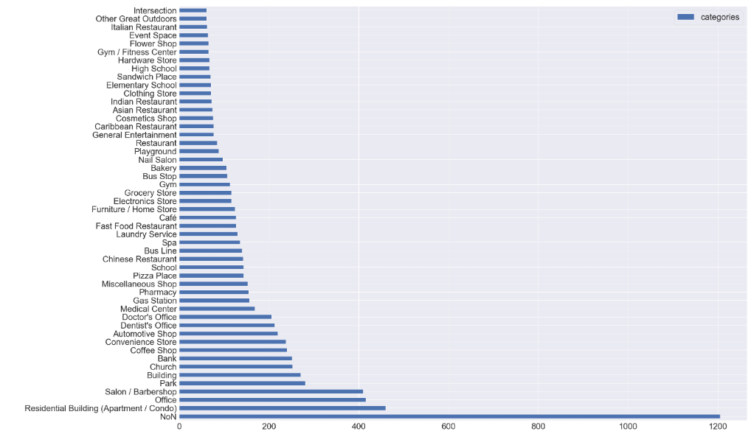
Most dominant categories in toronto

Slide 5
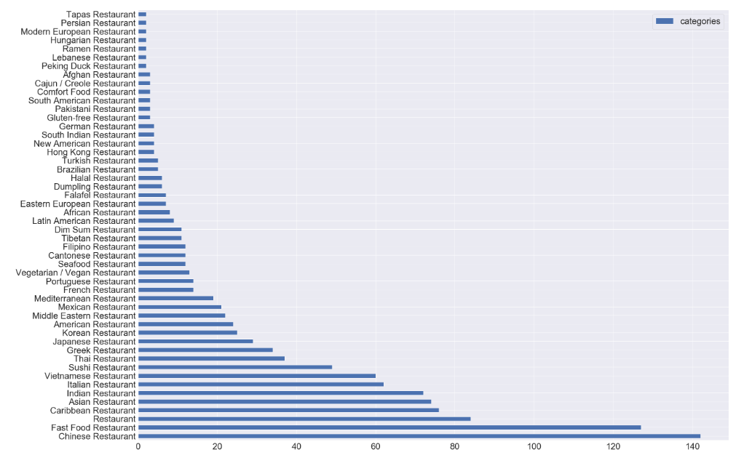
Most dominant restaurant categories in toronto

Slide 6
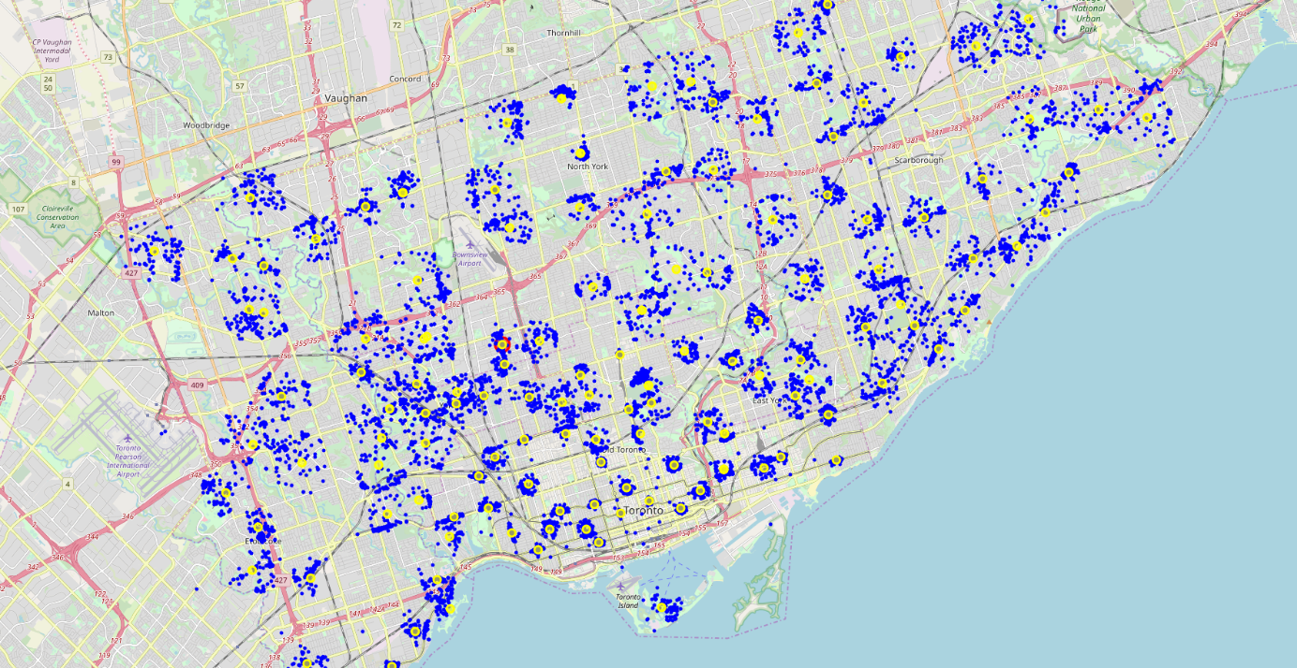
layout of the sites compared to neighborhood a Toronto.

Slide 7
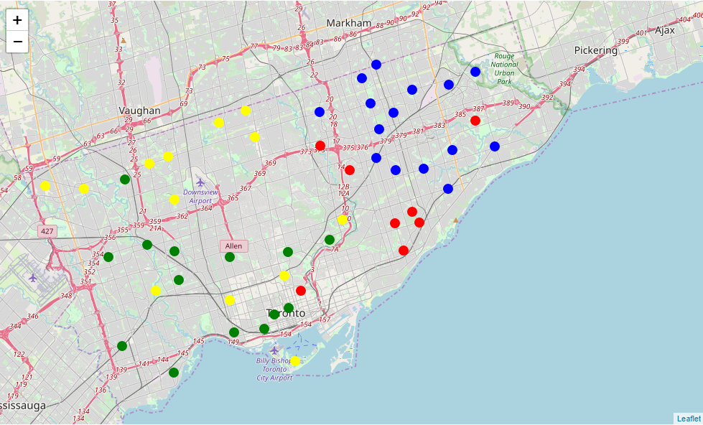
neighborhood clusters

Slide 8
The criteria for opening a restaurant depend partly on the category of restaurant, if you want to open a Chinese restaurant, you target neighborhoods with a Chinese population quite present, as well as for an Italian restaurant or other.
The Chinese restaurants and the fast foods are the most present by conceiving the competition is rough so it is preferable to choose another category.
I recommend the East Willowdale, Mount Olive-Silverstone-Jamestown, Waterfront Communities-The Island and Dovercourt-Wallace Emerson-Junction neighborhoods to open a restaurant because they are part of a cluster that has the fewest restaurants so less competition and they have a high demographic score so it is favorable to a high turnover.

Slide 9
Thanx

